Slide 1


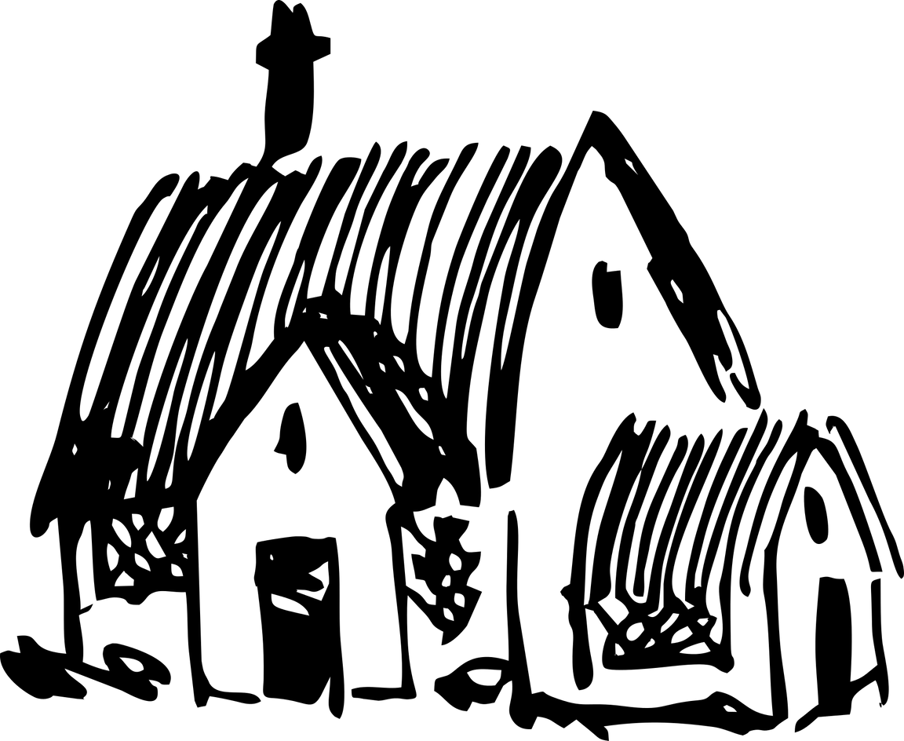
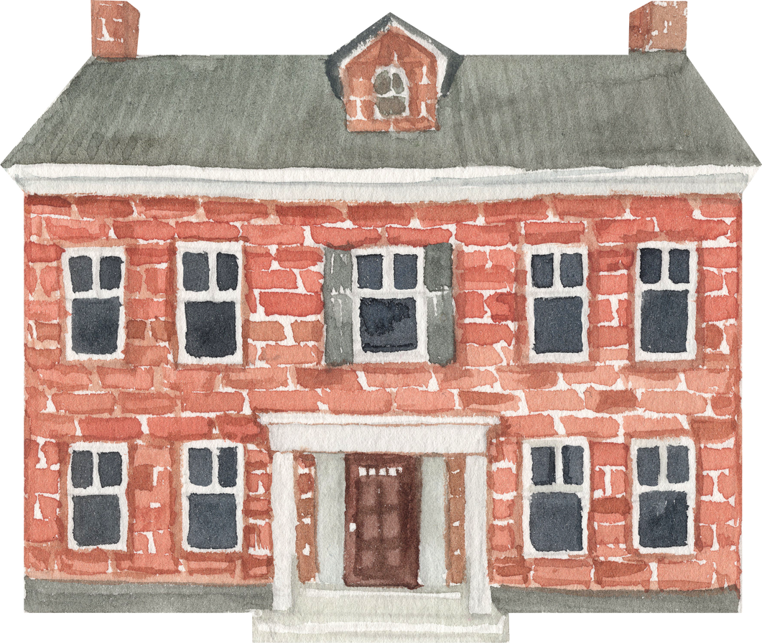


English YEAR 2
module 6
the old house

Slide 2

LEARNING OBJECTIVES
By the end of the lesson, pupils will be able to:
1.Understand with support specific information and details of simple sentences.
2.Spell a narrow range of familiar high frequency words accurately in guided writing.

Slide 3


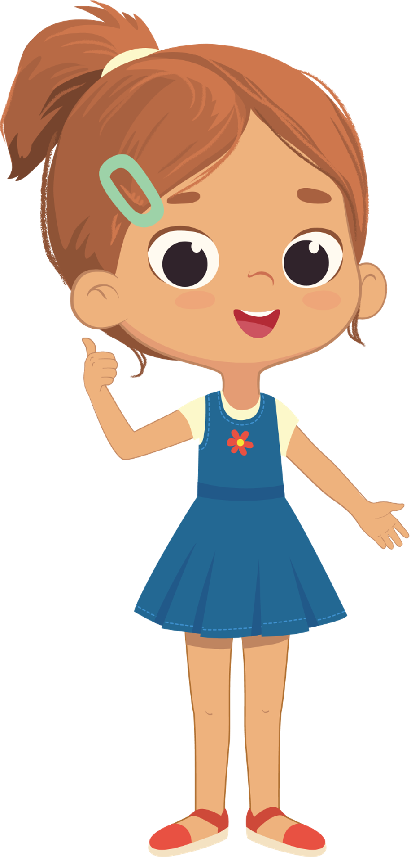

Let's enter the old house and see what's in there !
What's in the living room?
The is a cat in the living room.
What's there in the dining room ?
There is a big old window in the dining room.
How many bathrooms are there ?
There are four bathrooms.

Slide 4
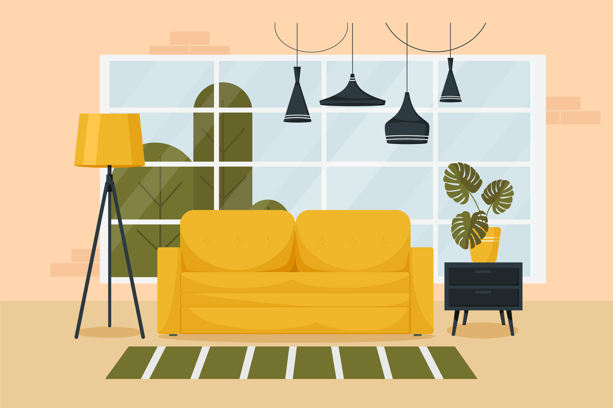
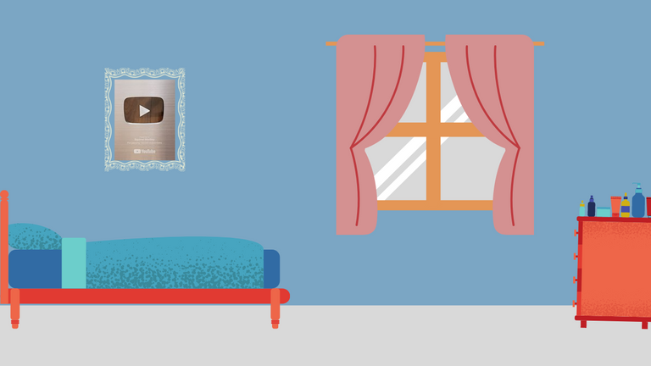

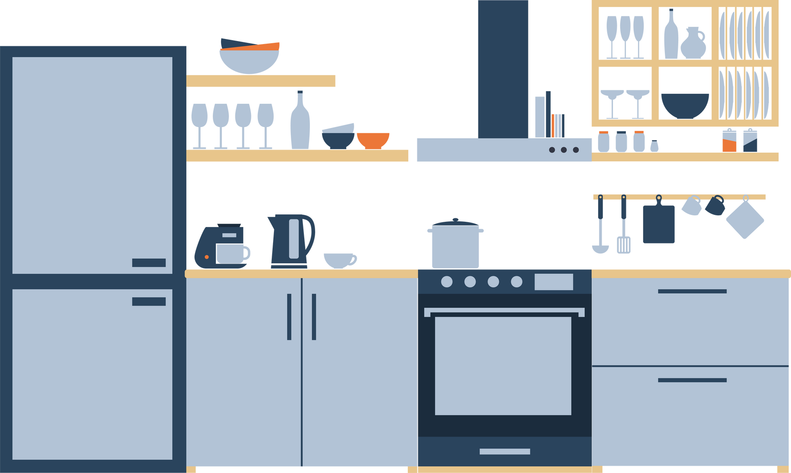
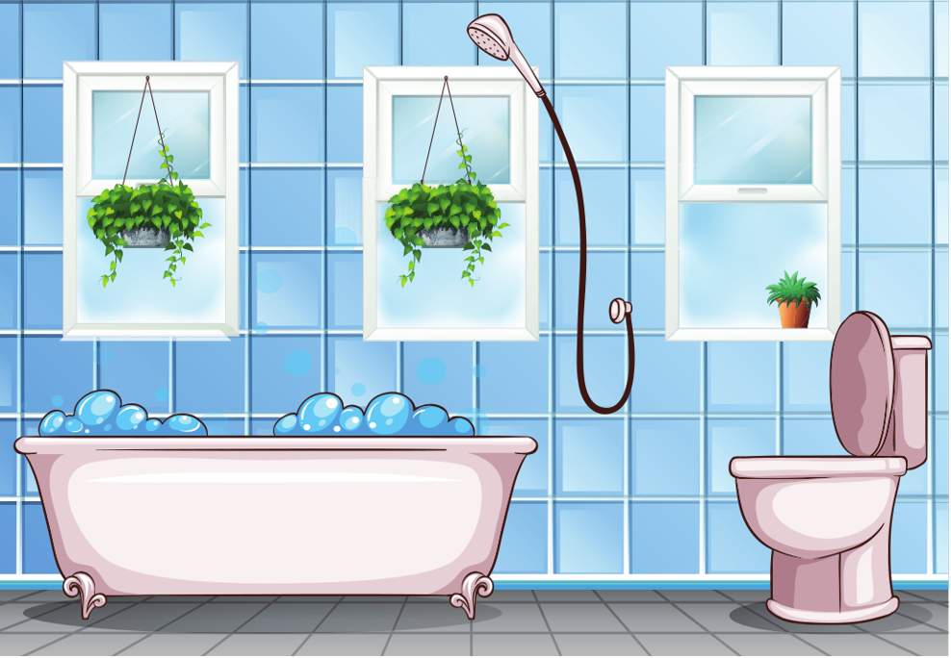
Let's look into different parts of the house.
Living room
Bedroom
Bathroom
Kitchen

Slide 5
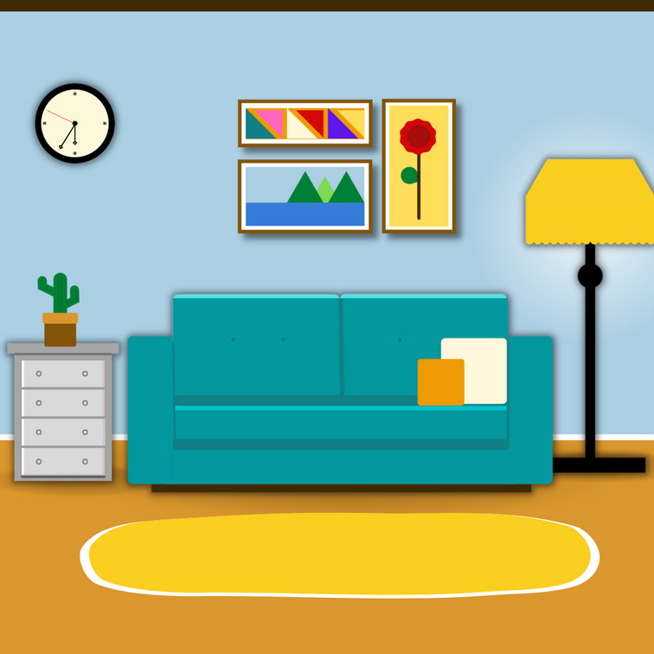

Observe the picture and describe it.
The old house has ...............
In the old house, I can see .............

Slide 6


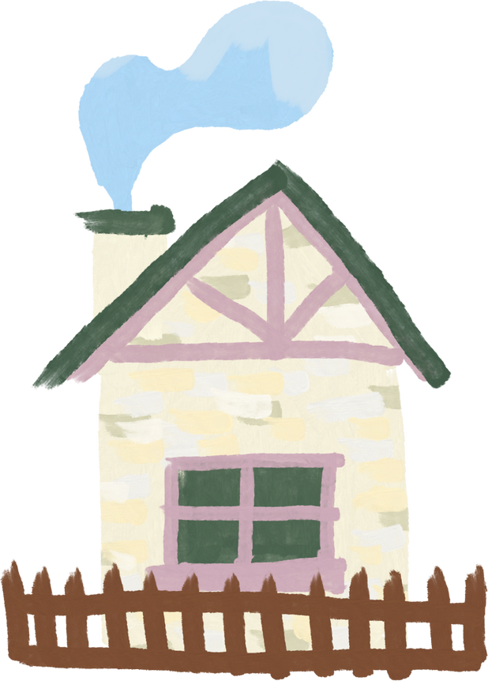
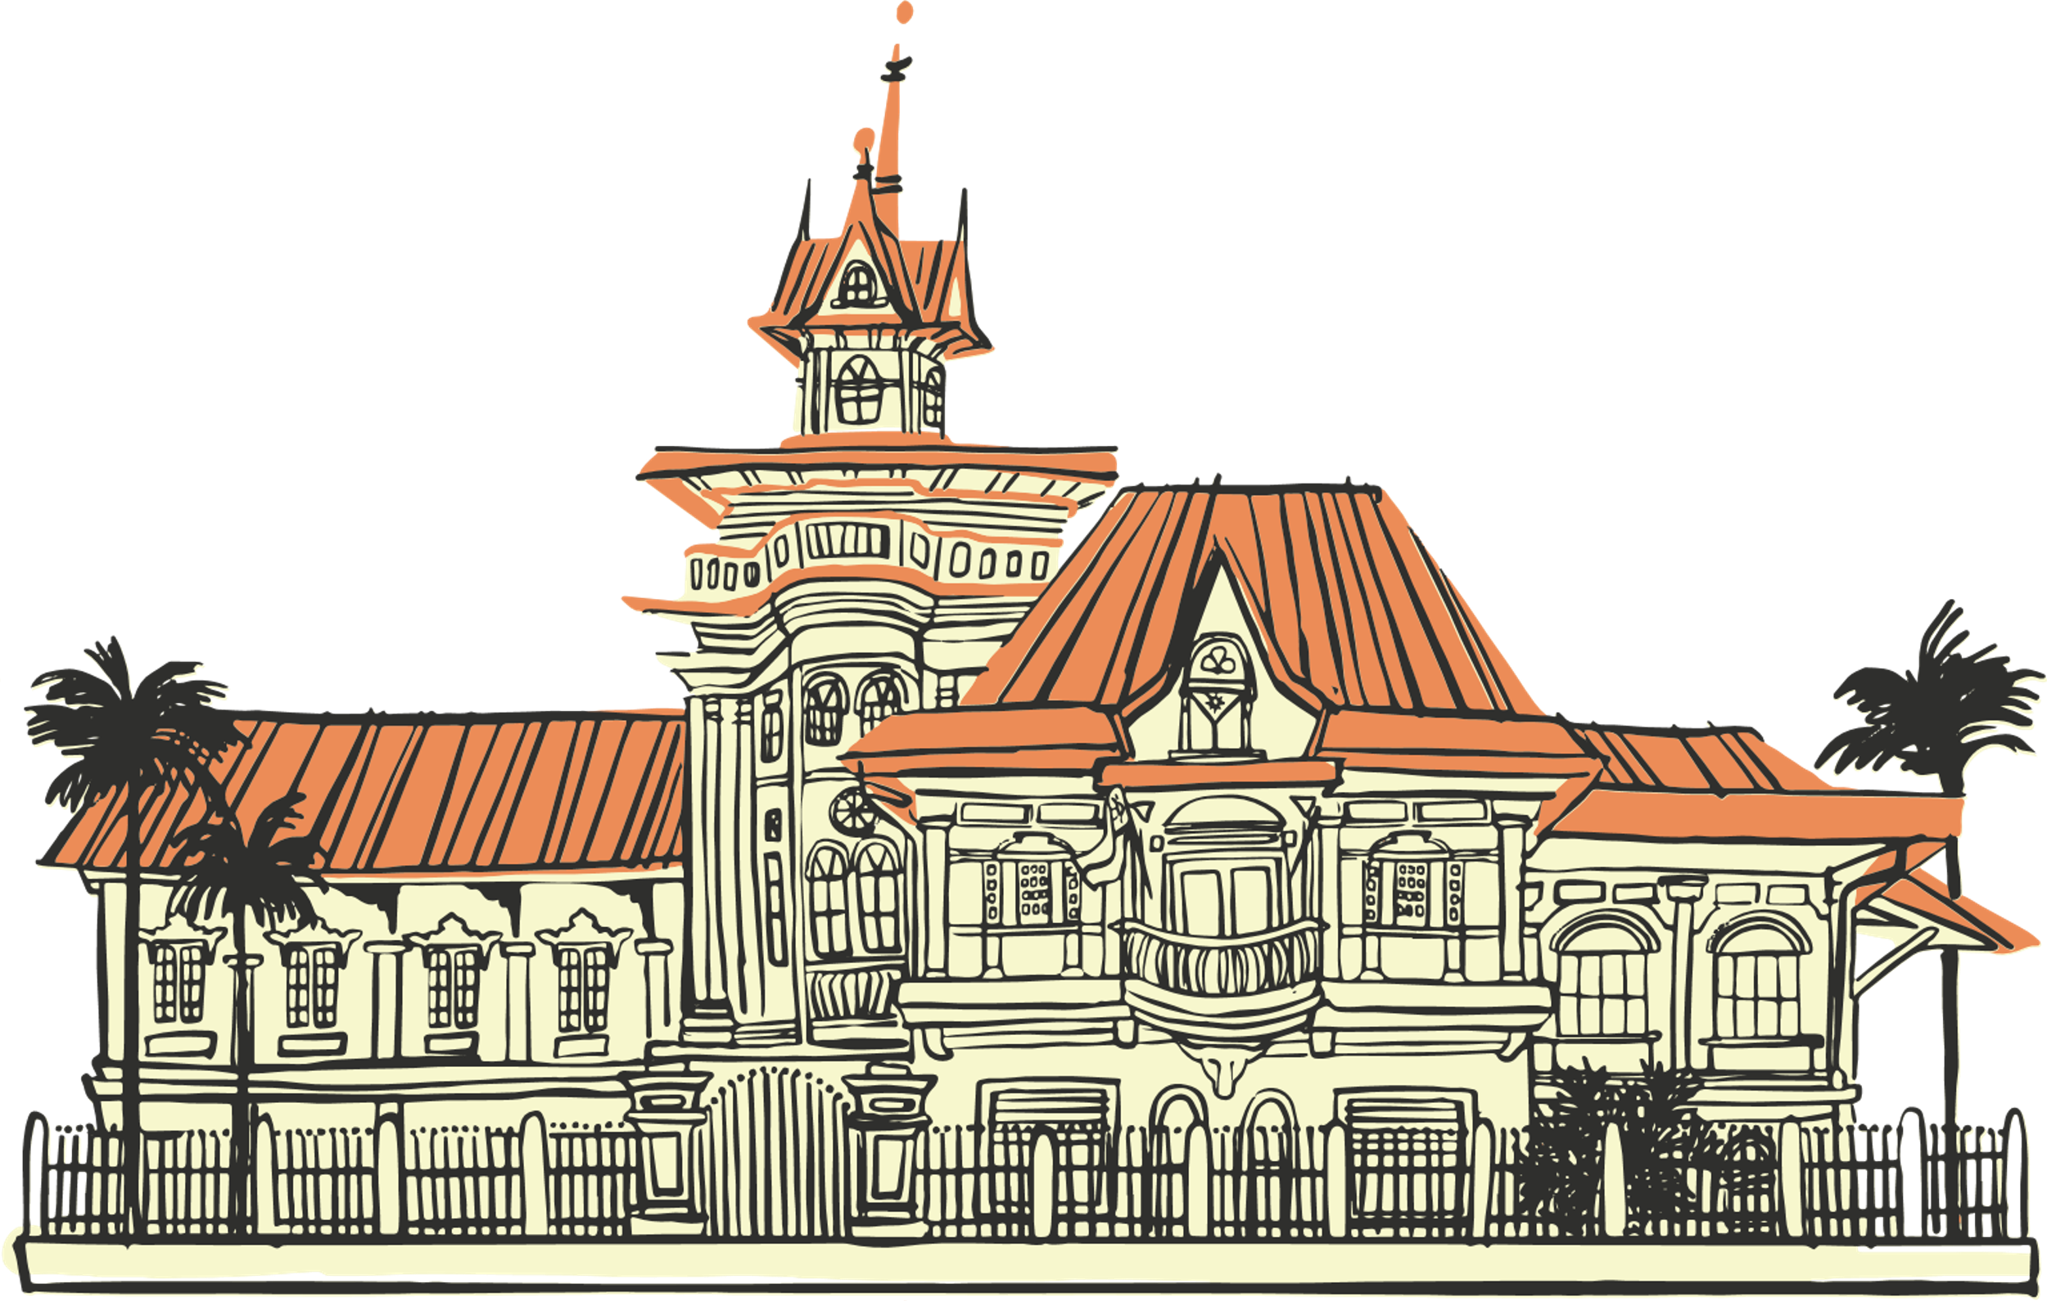
WHAT DID WE LEARN ?

Slide 7



Thank you, class!
You are awesome!
Let's learn more in
another session.

